Slide 1



3D Visualization with the ArcGIS API for JavaScript
Kristian Ekenes
Javier Gutierrez

Slide 2

API Overview
Renderers, symbols, symbol layers…

Slide 3

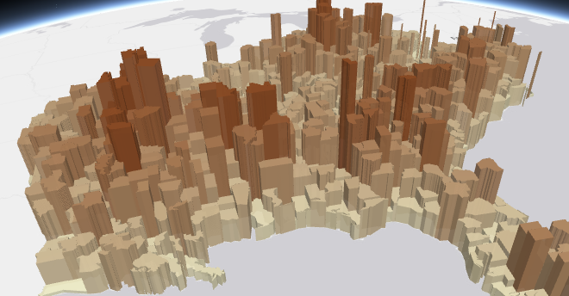
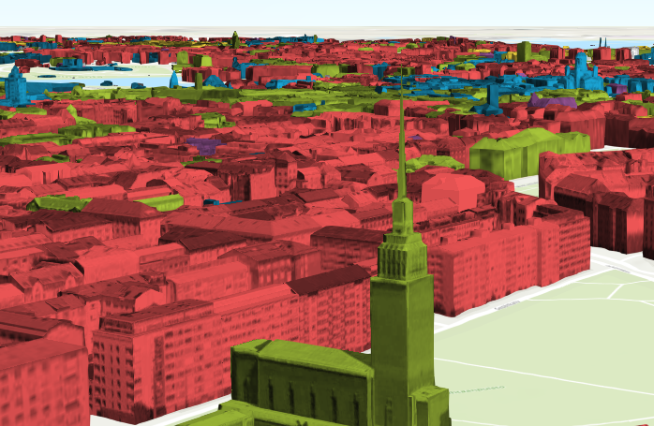
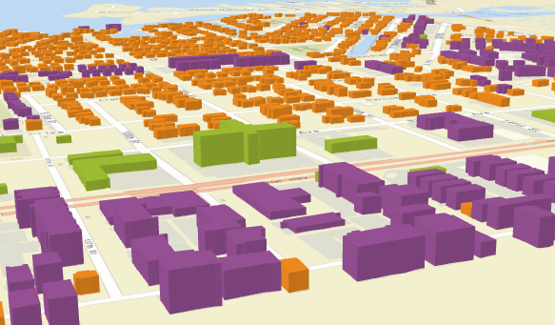
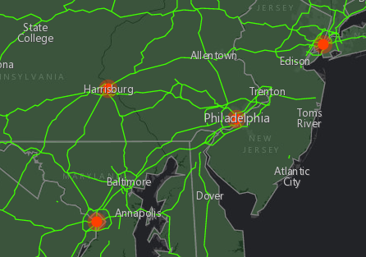
What can we visualize?
Location
Types
Data (numbers)
Combinations of the above

Slide 4
Data
FeatureLayer
MapImageLayer
SceneLayer
Includes 2D data sources
CSVLayer
PointCloudLayer
StreamLayer

Slide 5
Data-driven visualization
Field value(s)
TOTAL_POP
Arcade expression
Round( ($feature.BACHELOR + $feature.MASTER) / $feature.POP_25UP) );
JavaScript function
function (graphic){
return graphic.attributes.POP_DENSITY;
}

Slide 6
Renderers

Slide 7
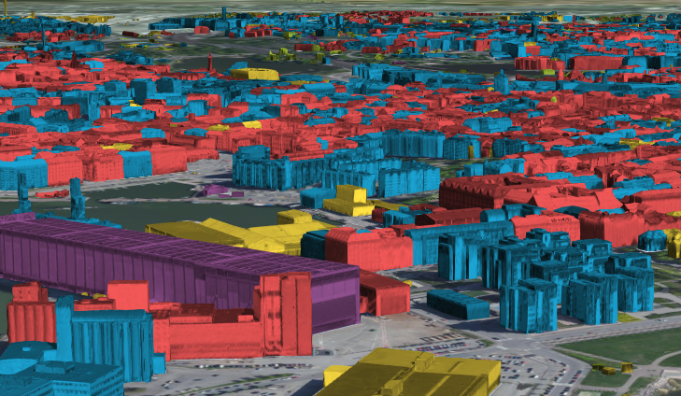
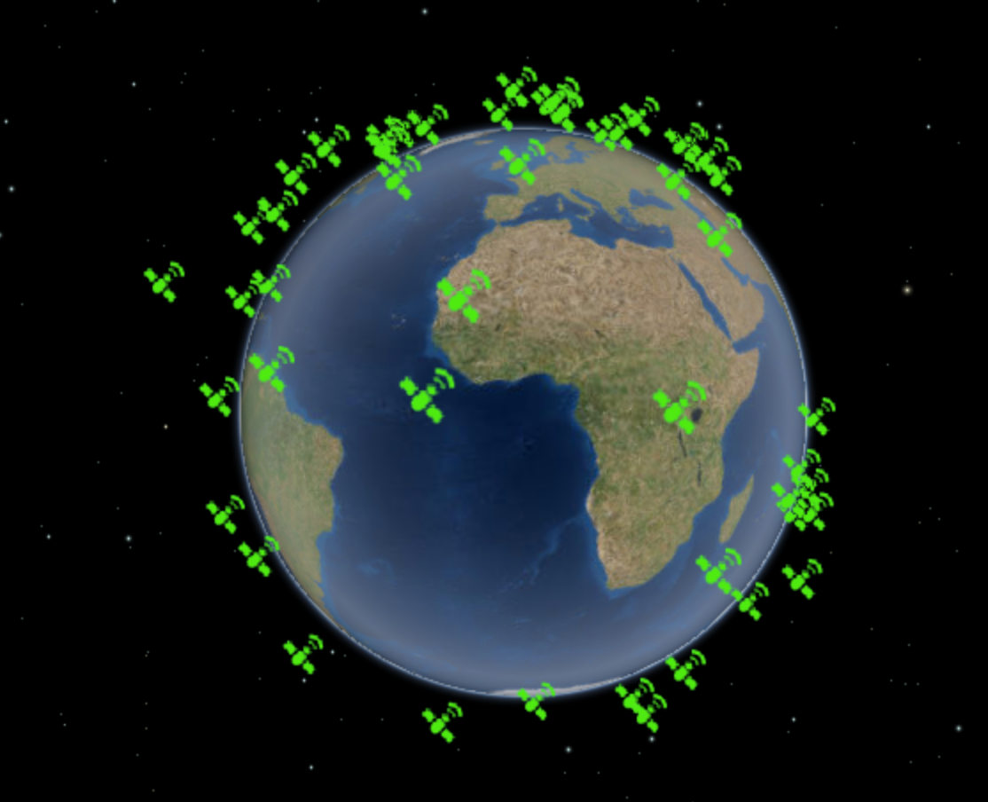
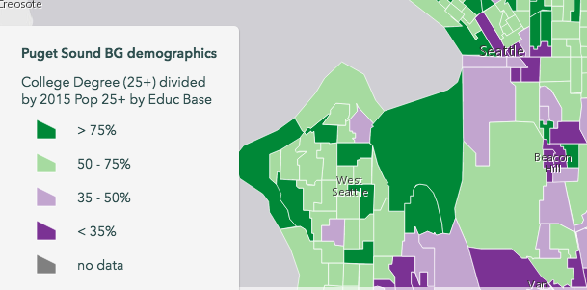
UniqueValueRenderer
Renderers
SimpleRenderer
ClassBreaksRenderer

Slide 8
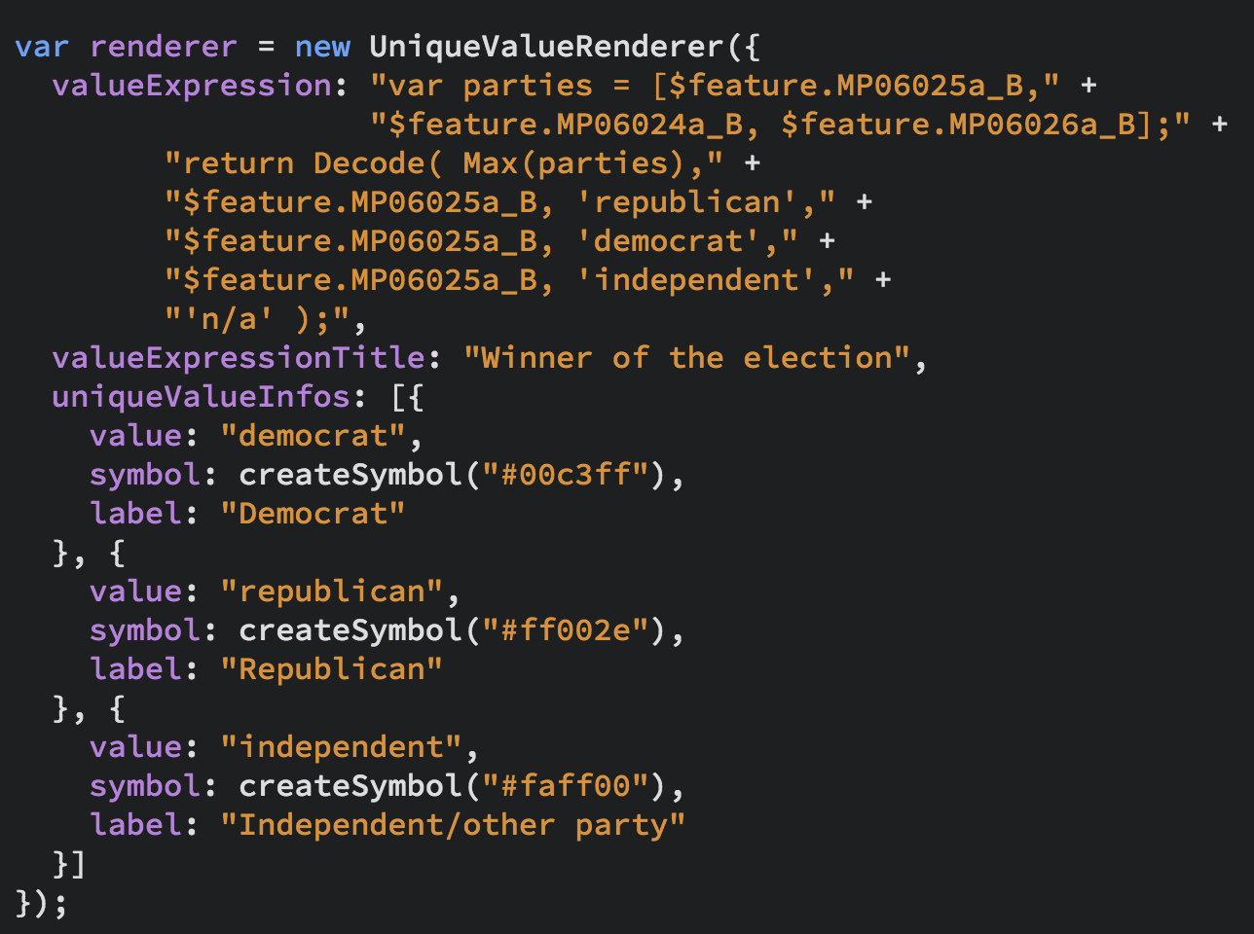
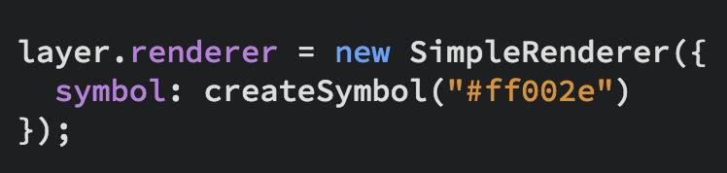
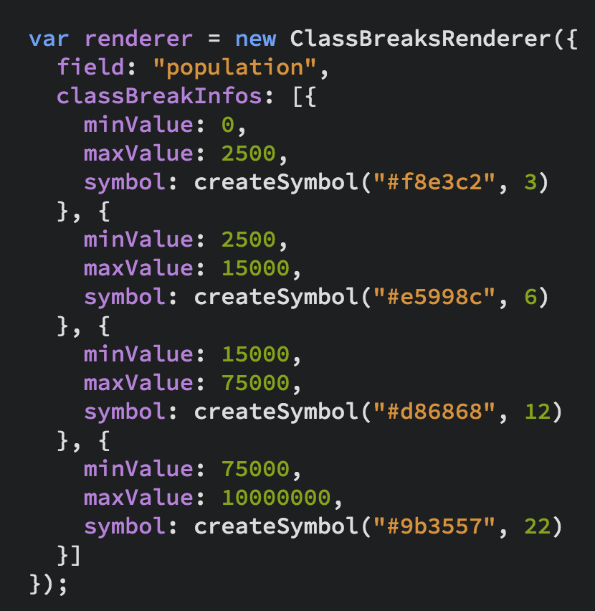
UniqueValueRenderer
Renderers
SimpleRenderer
ClassBreaksRenderer

Slide 9
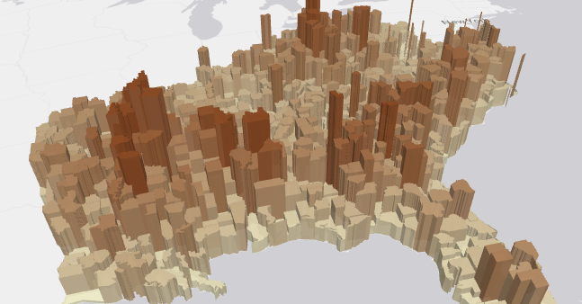
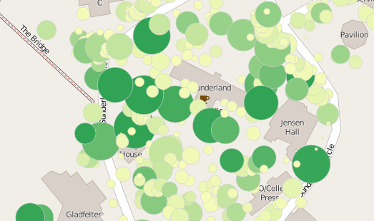
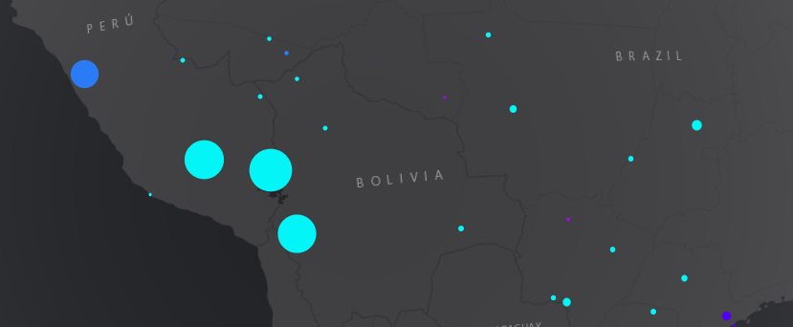
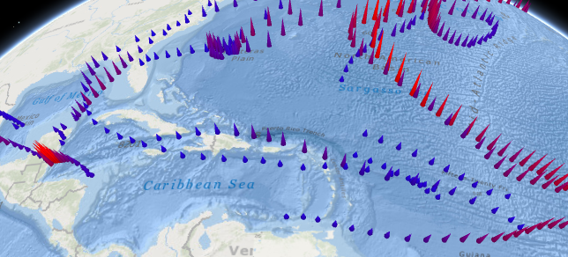
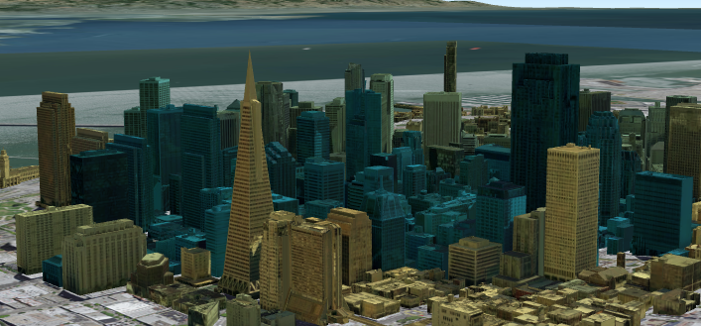
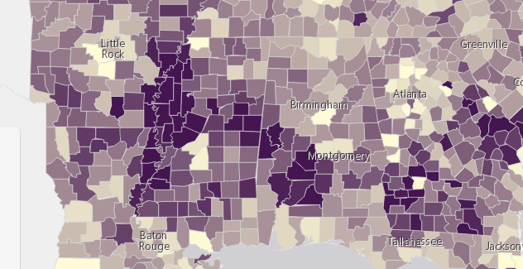
Renderers
Visual Variables
A property of the renderer
For numeric data-driven continuous visualizations
Color
Size
Height
Width
Depth
Opacity

Slide 10
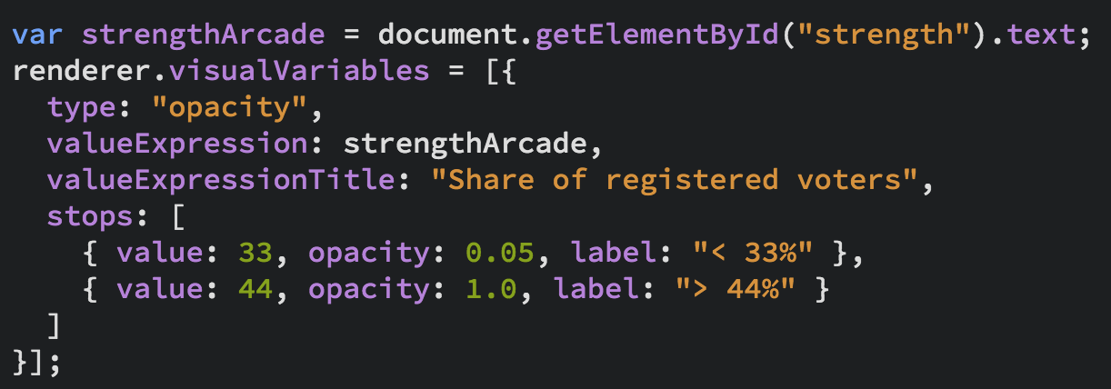
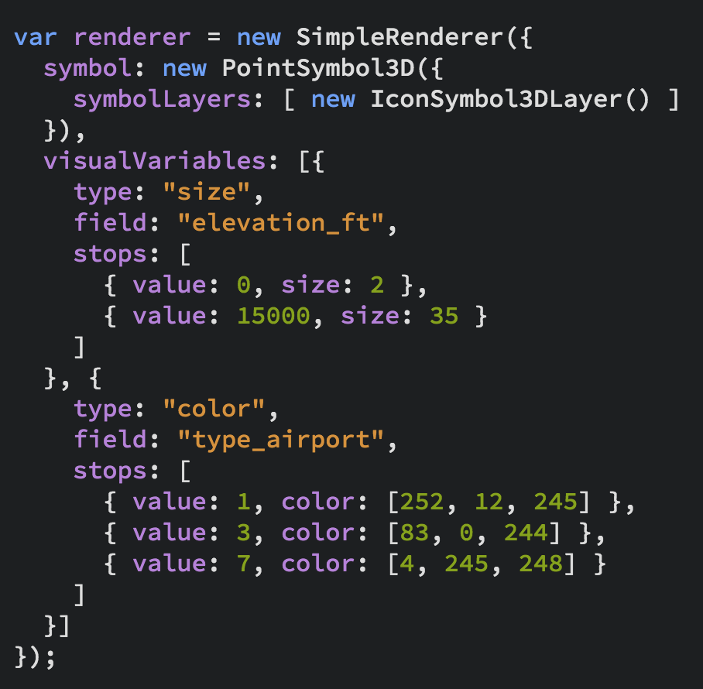
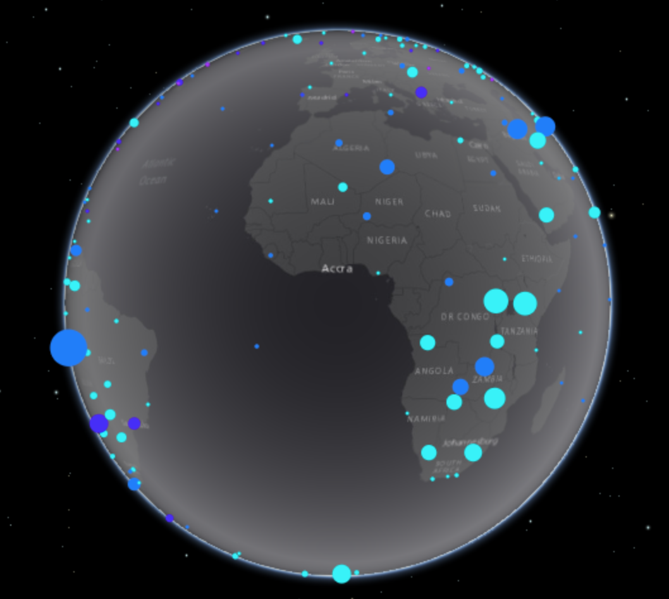
Renderers
Visual Variables

Slide 11
Symbols
And symbol layers

Slide 12
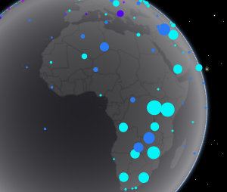
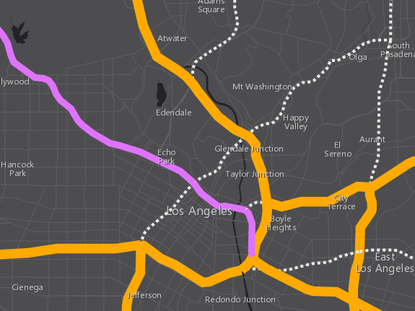
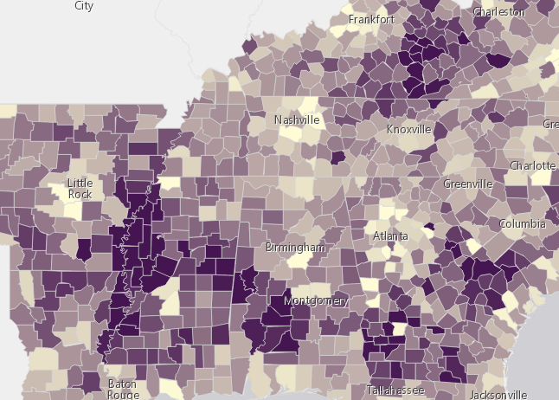
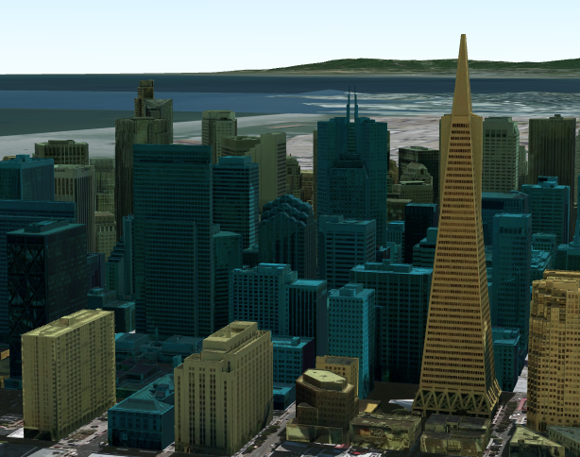
3D Symbols
based on geometry type
Points
Lines
Polygons
Mesh
PointSymbol3D
LineSymbol3D
PolygonSymbol3D
MeshSymbol3D

Slide 13
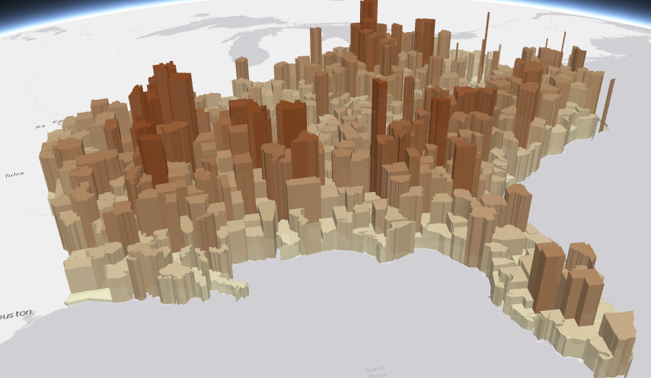
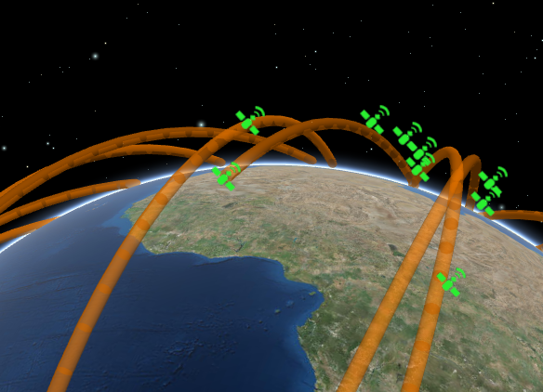
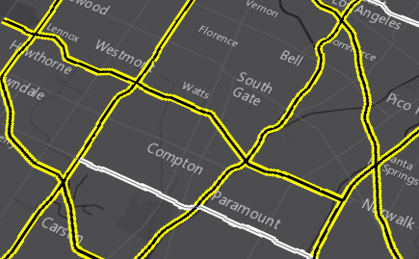
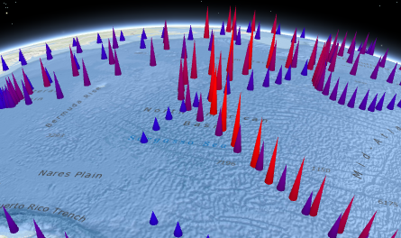
3D Symbols
Each must be composed of one or more symbol layers
Flat
Size is expressed in
screen units
Volumetric
Size is expressed in
real-world units
IconSymbol3DLayer
ExtrudeSymbol3DLayer
PathSymbol3DLayer
FillSymbol3DLayer
LineSymbol3DLayer
ObjectSymbol3DLayer

Slide 14
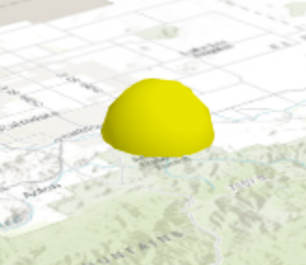
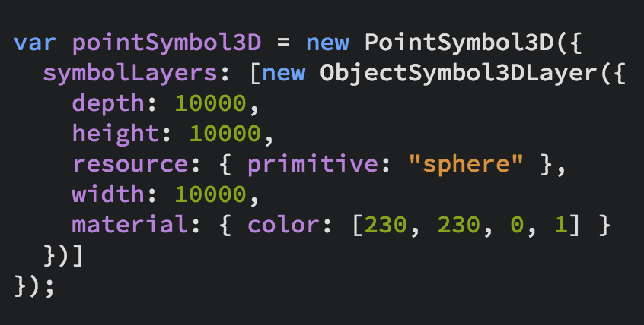
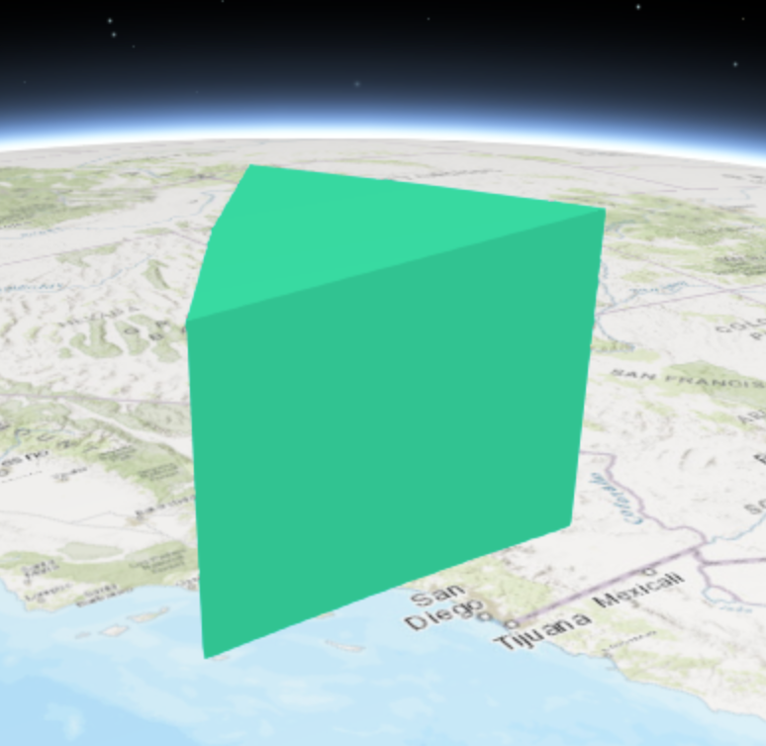
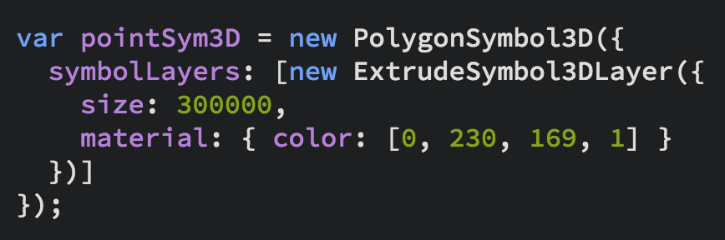
3D Symbols

Slide 15
Examples

Slide 16

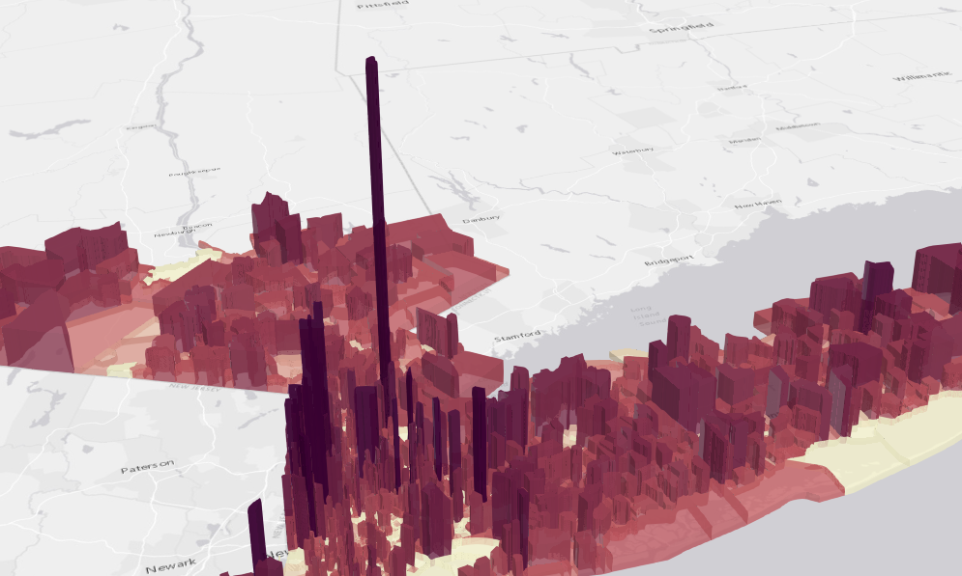
Extrusions

Slide 17
Colorized building textures

Slide 18
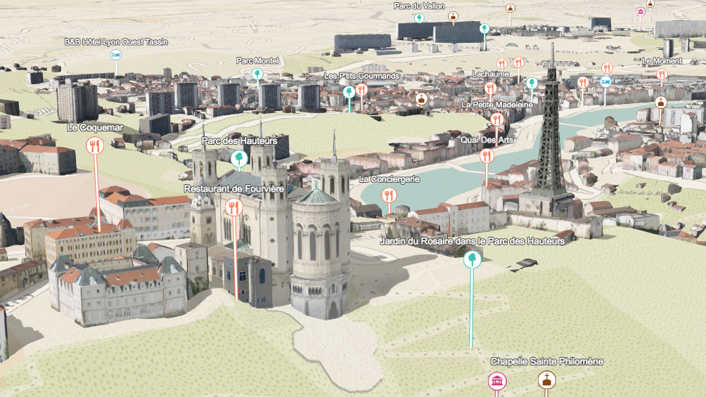
Points of interest

Slide 19
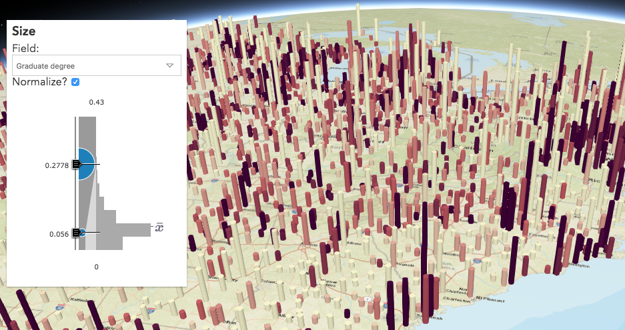
Data exploration
Smart mapping in custom apps

Slide 20
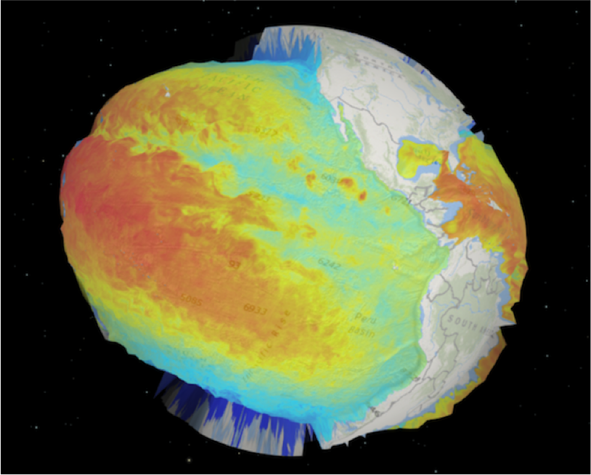
Abstract visualizations
Thematic values as elevation

Slide 21
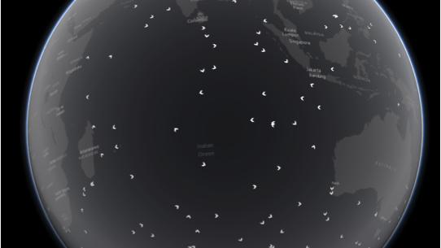
Advanced concepts
Extend underlying WebGL engine

Slide 22
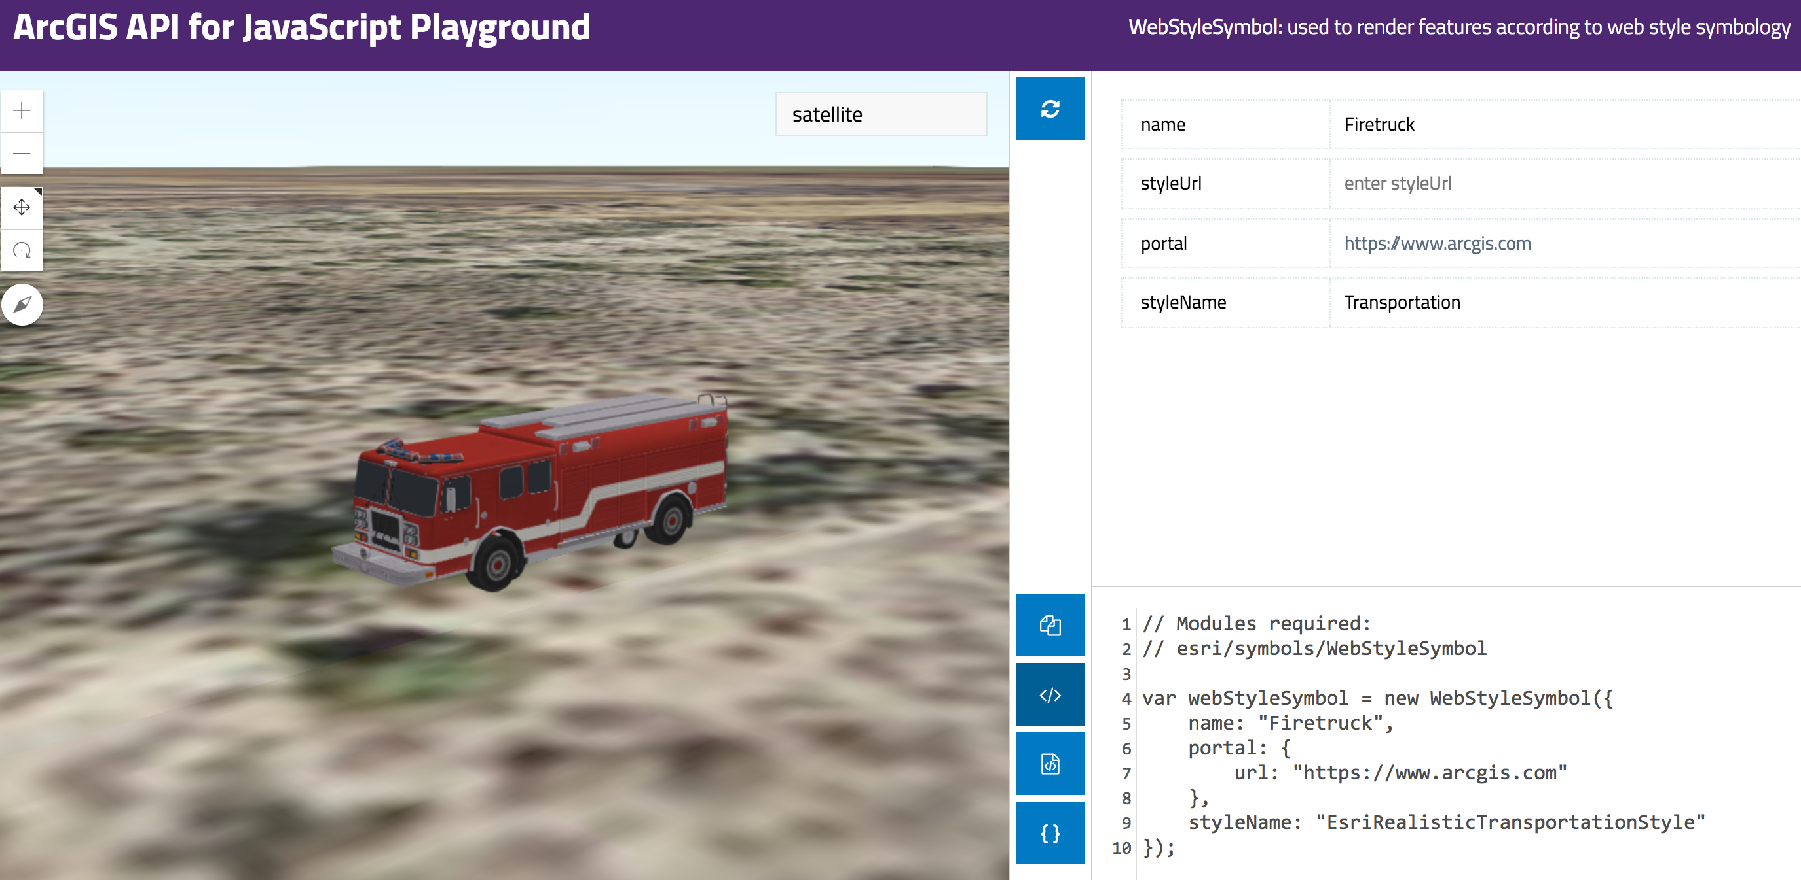
Resources
Get started with visualization
ArcGIS Blog
Icons, lines, fills
Objects, paths, extrusion
Real world sizes
Documentation
Renderer
Symbol3D
Symbol3DLayer

Slide 23



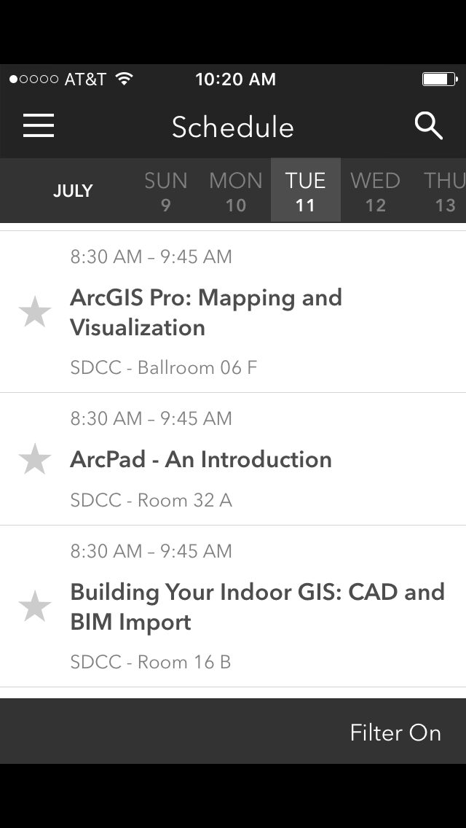
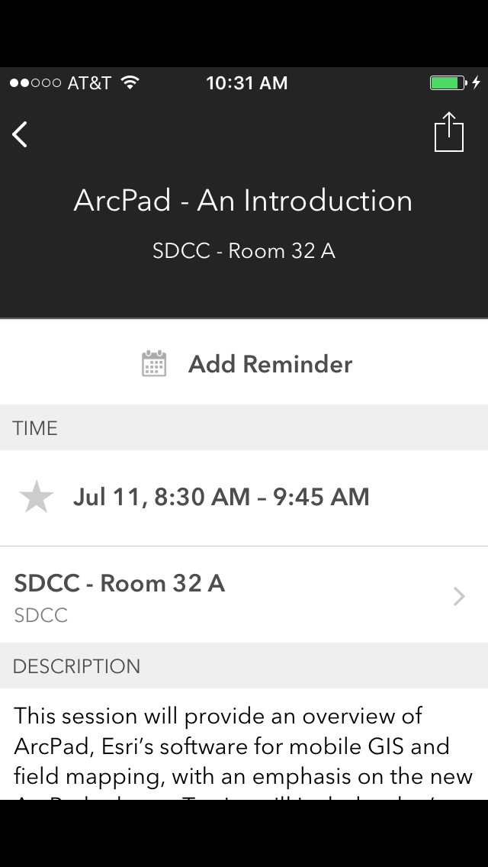
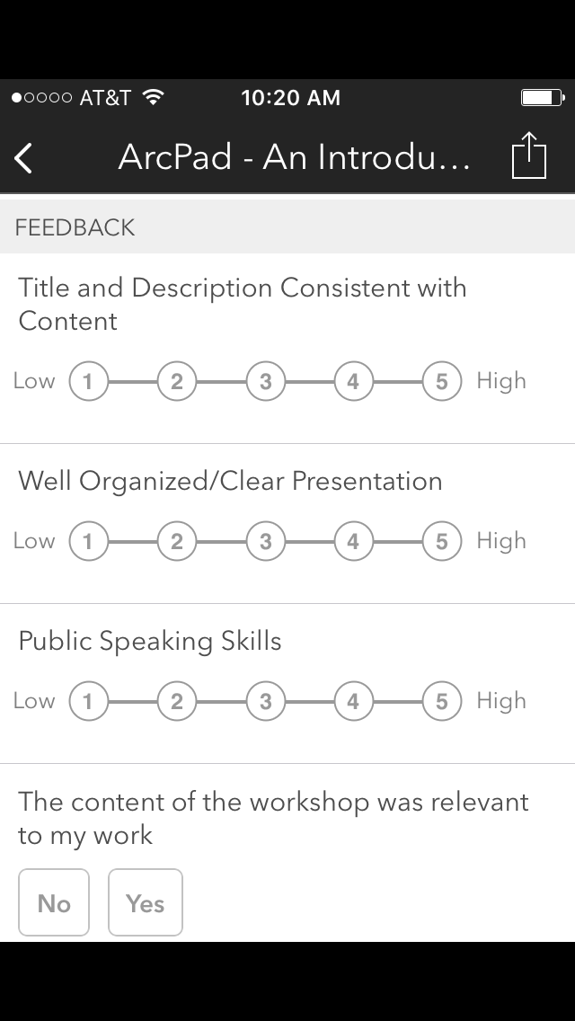

Please Take Our Survey on the Esri Events App!
Download the Esri Events app and find your event
Select the session you attended
Scroll down to find the survey
Complete Answers
and Select “Submit”

Slide 24



